Slide 1

CCD vs. FABRIK
Who is the queen of IK solvers?

Slide 2
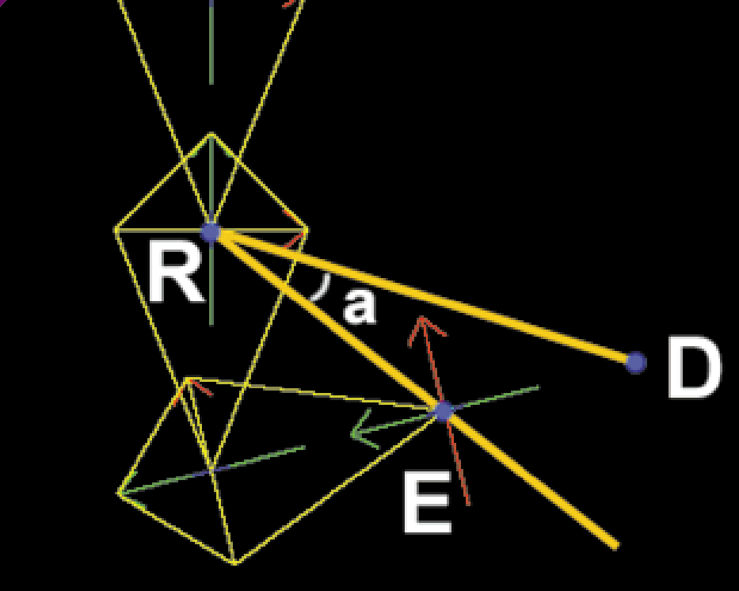
CCD: Composing quaternions
Record unit vectors + lengths
Compute quaternions between consecutive vectors
While error (goal – target) > threshold:
Go from target joint to base, try to align target-current vector
with goal-current vector by composing rotations
(quaternion conjugation)

Slide 3
Extensions
Multiple targets - Greedy: approach closest to root => furthest from root
Tree – need to access parent node

Slide 4
FABRIK
Algorithm already explained
Doesn’t need vectors, only positions + lengths
Also means can’t manipulate intermediate joints (at least not directly)

Slide 5

Video

Slide 6
comparisons

